Slide 1

Deep Learning-Based Classification of Plant Leaf Using MobileNetV3
This presentation explores the application of deep learning, specifically the MobileNetV3 architecture, to classify plant leaves. It covers the training process, evaluation metrics, and visualization of model performance.
Overview of MobileNetV3 Architecture
Dataset Preparation and Pre-processing
Model Training and Hyperparameter Tuning
Model Evaluation Metrics and Performance Analysis
Visualization of Model Performance
Comparison with Other Deep Learning Models
Done By : Gopinath P(192225090)

Slide 2

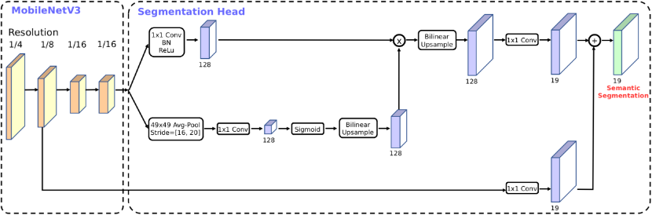
Overview of MobileNetV3 Architecture
1
Lightweight and Efficient
2
Improved Accuracy
MobileNetV3 is a highly optimized deep learning model designed for efficient inference on mobile devices and resource-constrained environments.
It incorporates advanced architectural components, such as squeeze-and-excitation blocks and inverted residual blocks, to achieve state-of-the-art accuracy in image classification tasks.
3
Flexibility
4
Widely Adopted
The architecture offers different variants (MobileNetV3-Large and MobileNetV3-Small) that allow for customization based on computational constraints and desired performance levels.
MobileNetV3 has gained popularity in various applications, including object detection, image segmentation, and natural language processing.

Slide 3
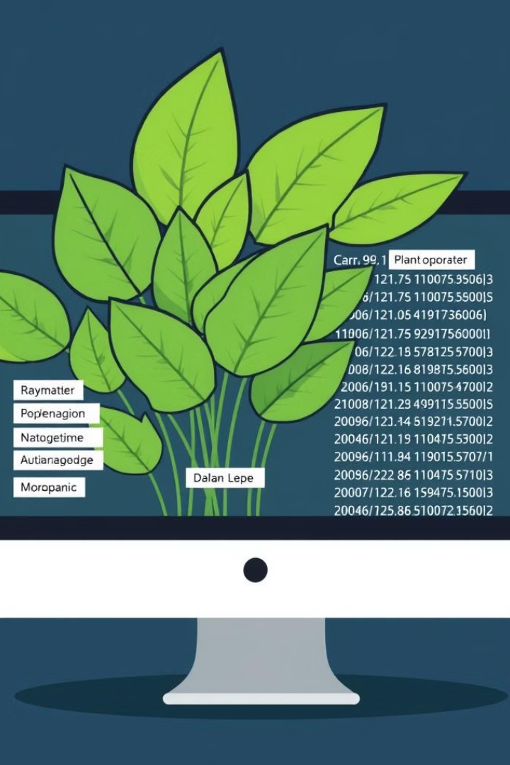
Dataset Preparation and Preprocessing
1
Data Collection
Gather a comprehensive dataset of plant leaf images from various sources, ensuring diverse species and growth stages.
2
Data Cleaning and Augmentation
Remove any corrupted or low-quality images. Apply data augmentation techniques (e.g., rotation, scaling, flipping) to increase the size and diversity of the dataset.
3
Data Splitting
Divide the dataset into training, validation, and testing sets. The training set is used to train the model, the validation set is used to monitor performance during training, and the testing set is used to evaluate the final model performance.
4
Data Normalization
Normalize the pixel values of the images to a standard range (e.g., 0-1) to improve model training and convergence.

Slide 4
Model Training and Hyperparameter Tuning
Model Initialization
Training Process
Hyperparameter Tuning
Initialize the MobileNetV3 architecture with appropriate weights (e.g., pre-trained weights from ImageNet). Select an appropriate optimizer (e.g., Adam, SGD) and learning rate.
Feed the training data to the model, iteratively adjust model weights to minimize the loss function (e.g., cross-entropy loss), and monitor performance on the validation set.
Optimize model hyperparameters (e.g., learning rate, batch size, number of epochs) to achieve optimal performance on the validation set.

Slide 5
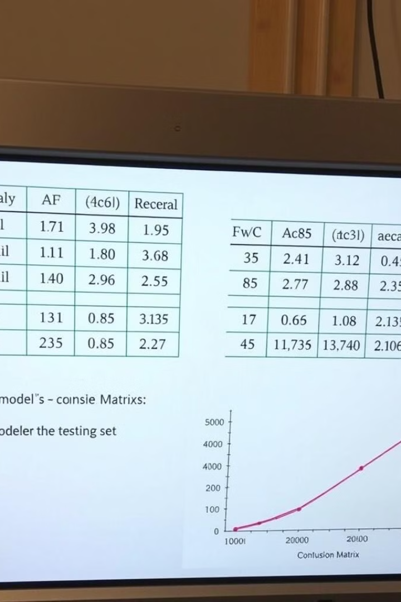
Model Evaluation Metrics and Performance Analysis
Metric
Description
Accuracy
Proportion of correctly classified instances.
Precision
Proportion of true positive predictions among all positive predictions.
Recall
Proportion of true positive predictions among all actual positive instances.
F1-score
Harmonic mean of precision and recall.

Slide 6
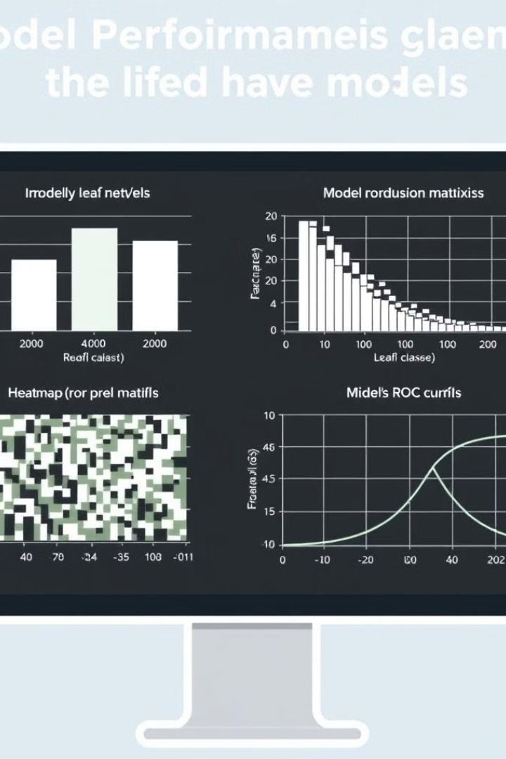



Visualization of Model Performance
Confusion Matrix
Visualize the model's predictions on the testing set, showing the number of correctly and incorrectly classified instances for each class.
ROC Curve
Plot the trade-off between true positive rate and false positive rate for different classification thresholds.
Precision-Recall Curve
Show the relationship between precision and recall for different classification thresholds.

Slide 7
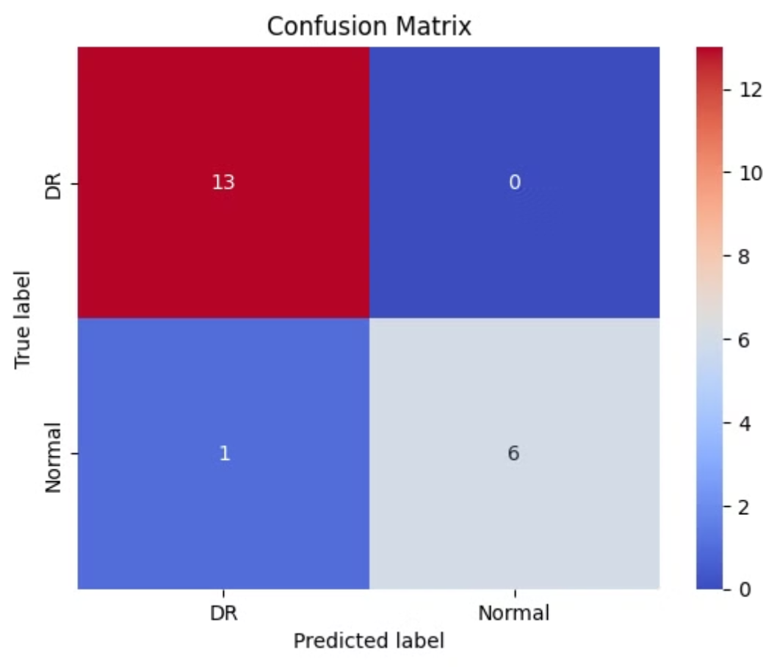

Slide 8
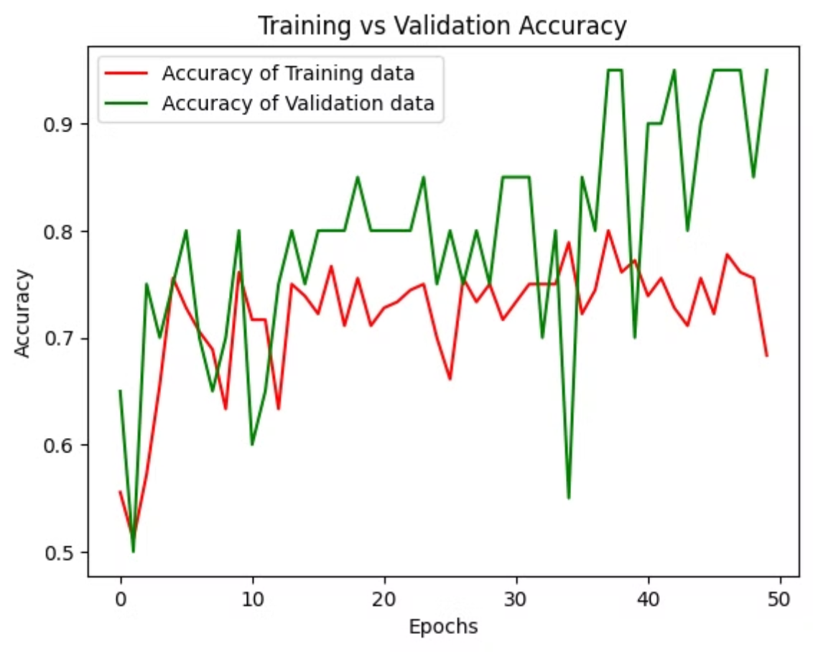

Slide 9
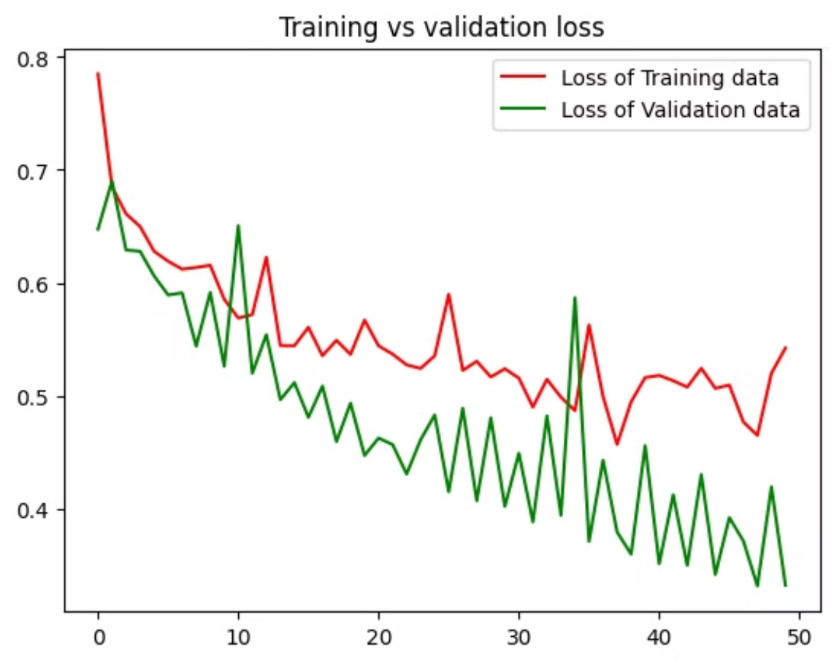

Slide 10
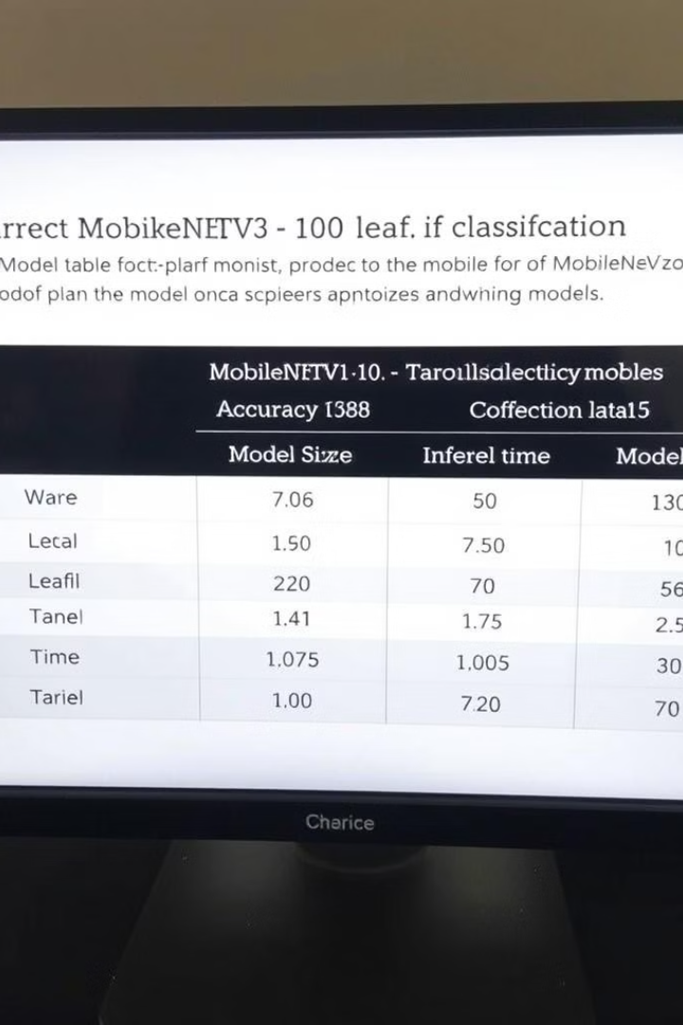
Comparison with Other Deep Learning Models
ResNet
VGG
Compare the performance of MobileNetV3 to other commonly used deep learning architectures, such as ResNet, for plant leaf classification.
Consider the trade-off between accuracy, computational efficiency, and model size when choosing the best model for a specific application.
EfficientNet
Analyze the strengths and limitations of different models to identify the most suitable approach for plant leaf classification.

Slide 11
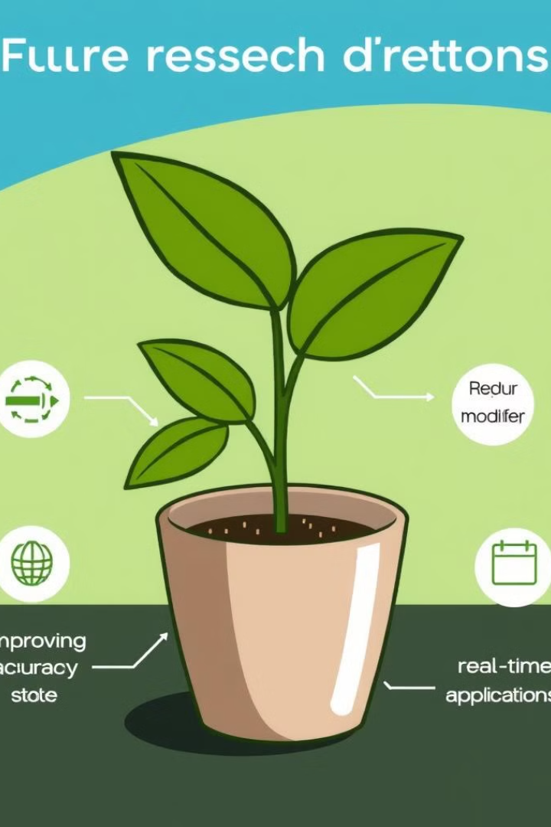
Conclusion and Future Directions
The study demonstrates the effectiveness of MobileNetV3 for plant leaf classification, achieving high accuracy and efficiency. Future work can focus on improving model accuracy, reducing model size for mobile deployment, and exploring real-time applications for plant disease detection.

